Slide 1
Unit 7:
New Trends in Operating System
Time:5 Hrs
Presented by
Er.Harendra Bikram Shah
(Lecturer)
Department of Computer Engineering
NAST

Slide 2
OUTLINES
-Concept , Character and Role of Real Time Operating System
-Distributed Operating System
-Cloud Operating System
-Mobile Operating System
-Security Issues and Method of Deployment
-Memory wall and Bottleneck for Operating System

Slide 3
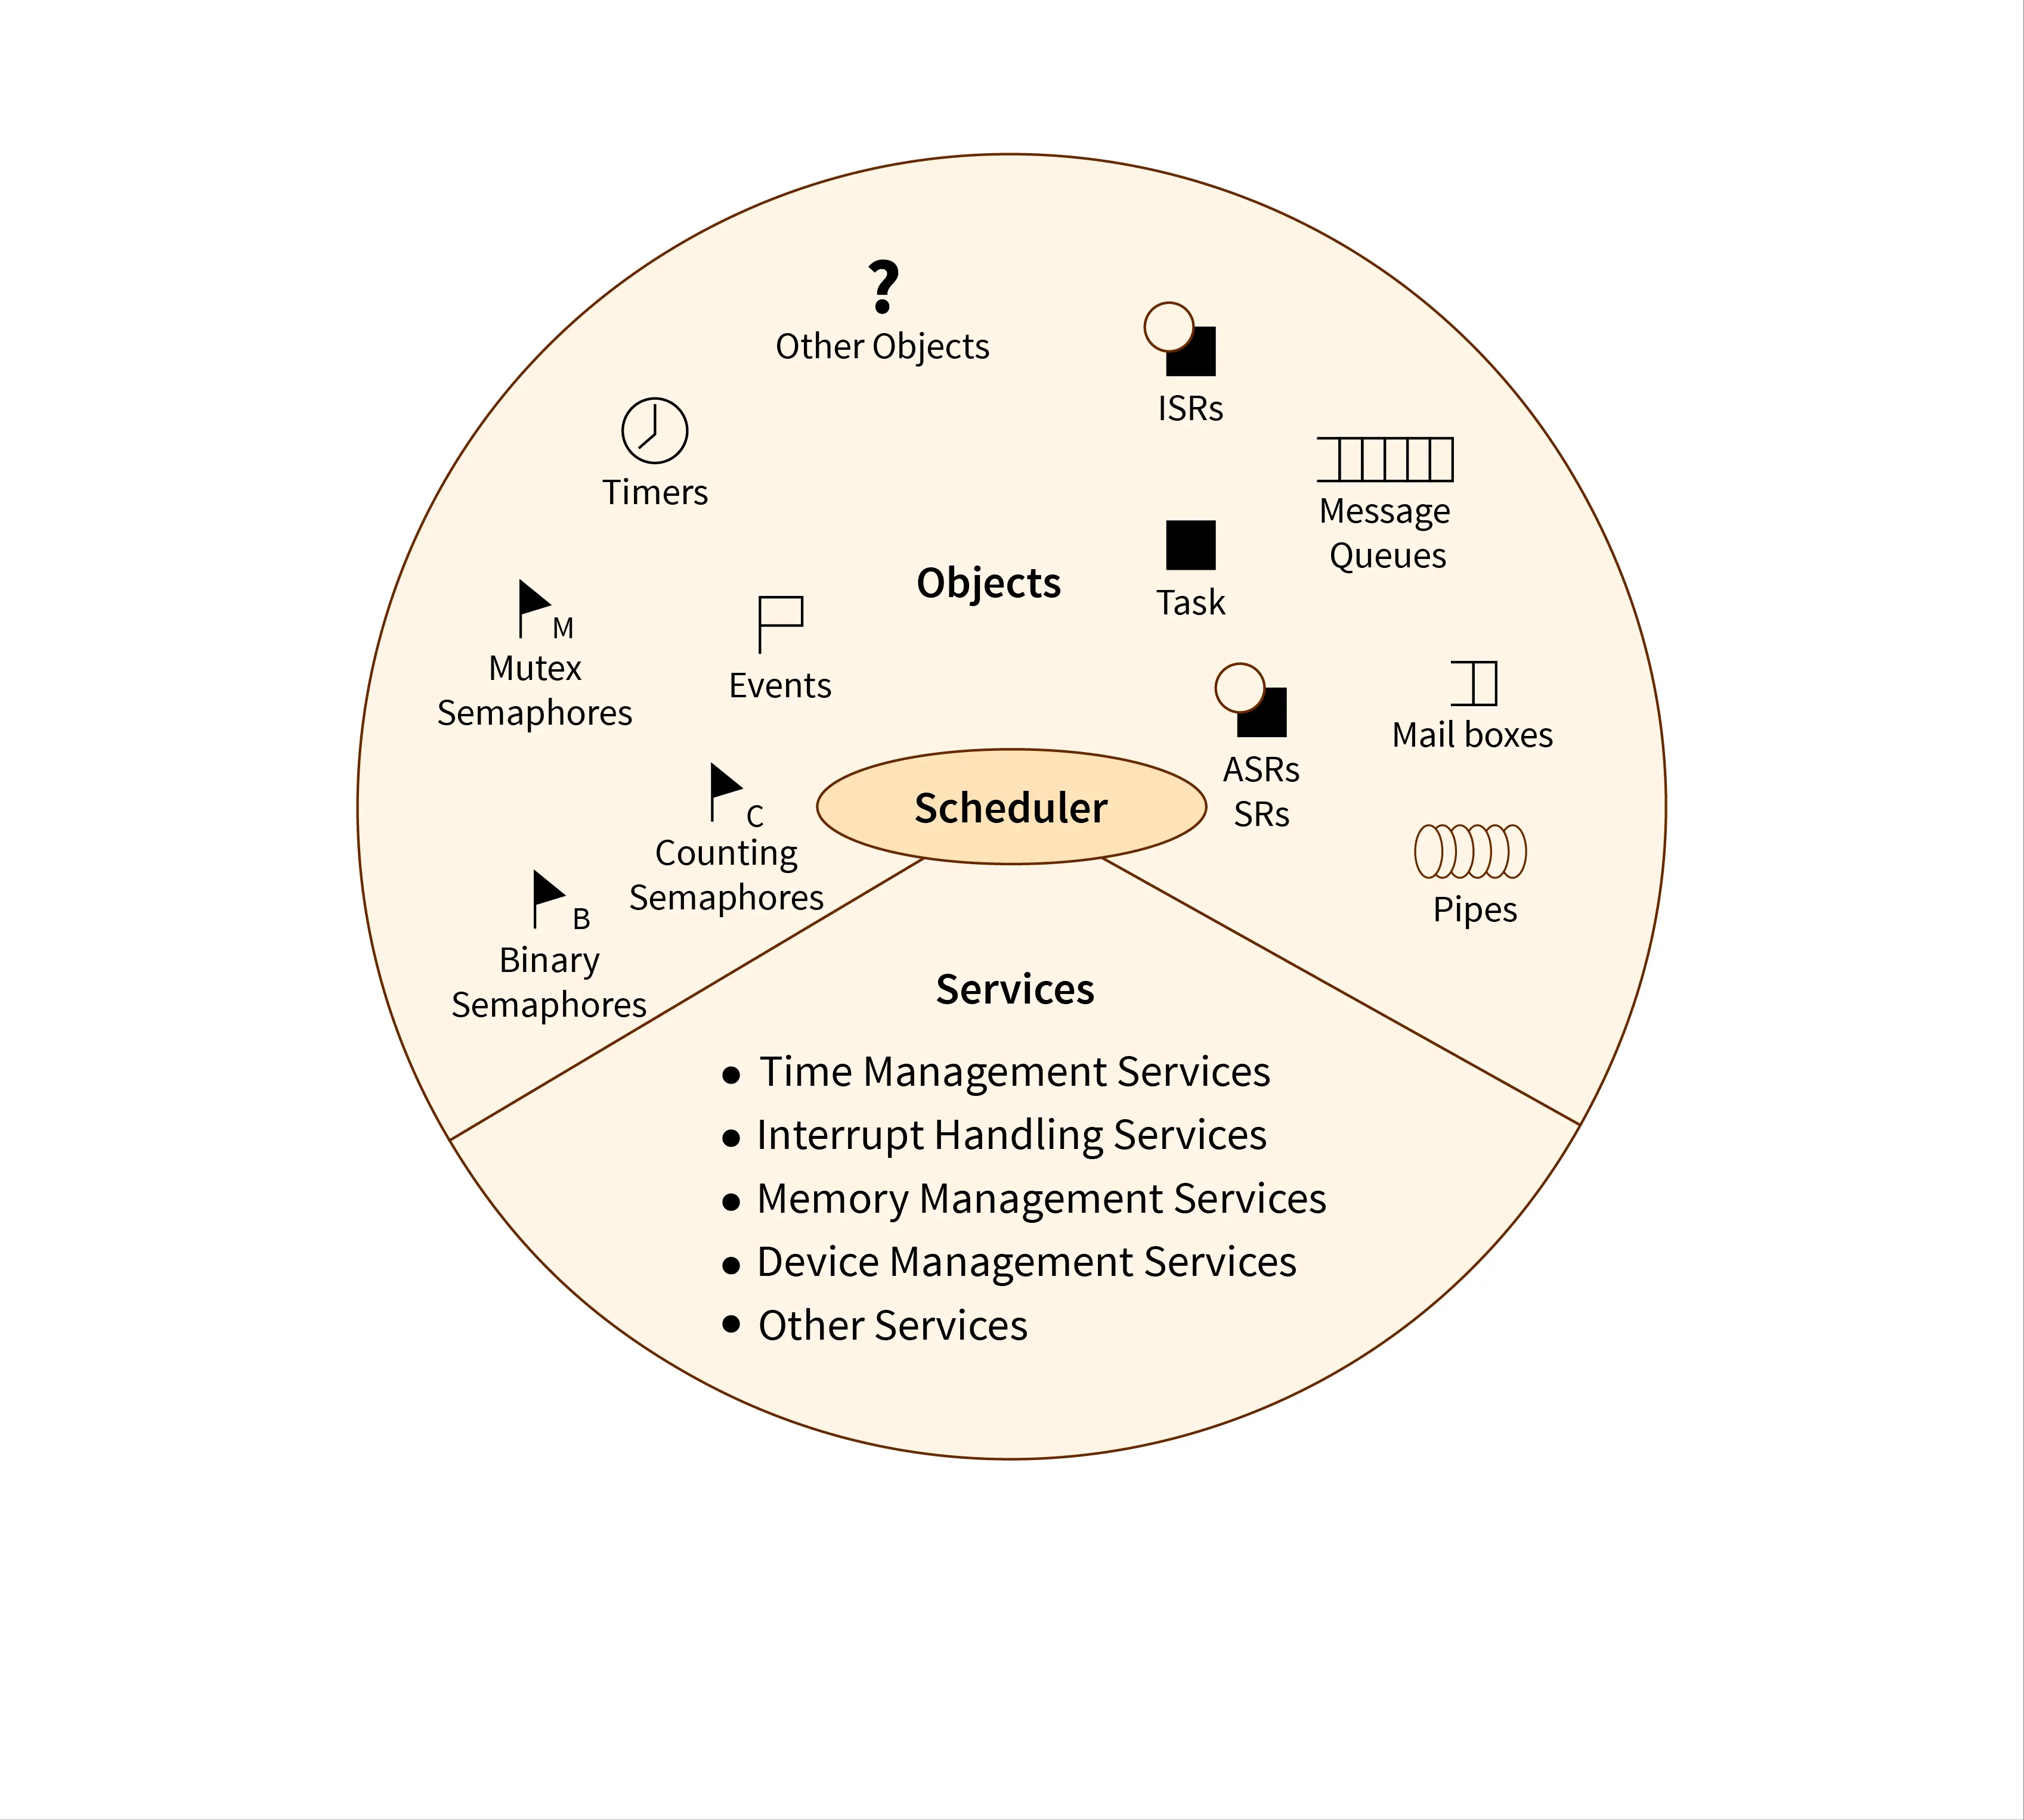
RTOS
Components of RTOS

Slide 4
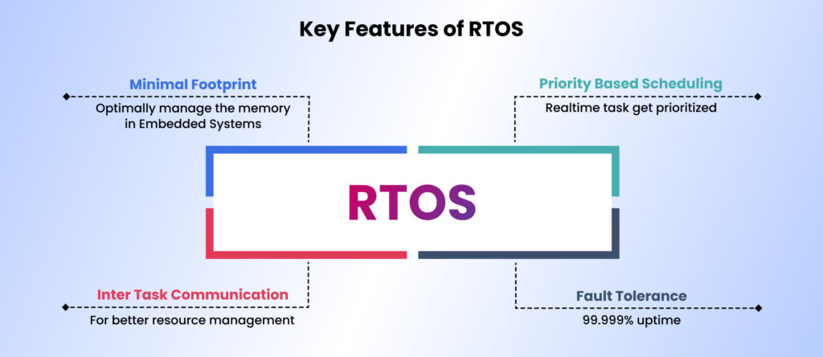

Slide 5
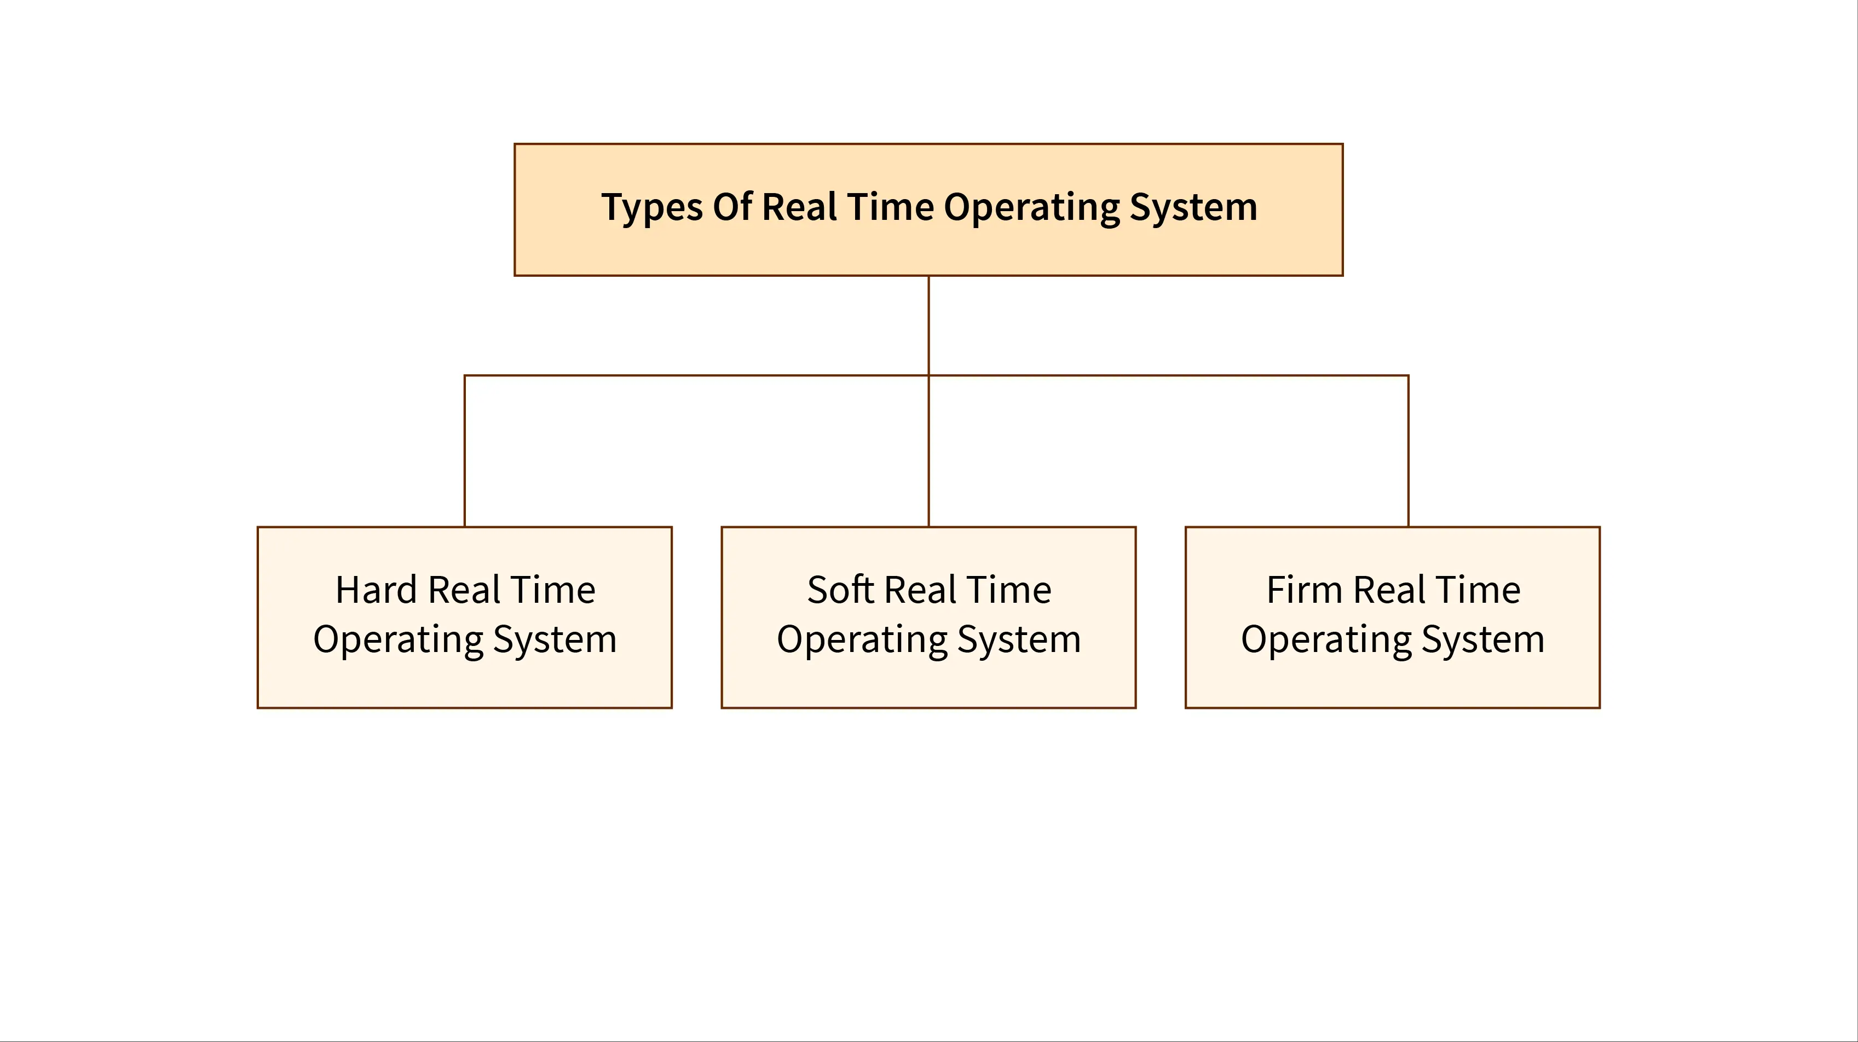
Introduction

Slide 6
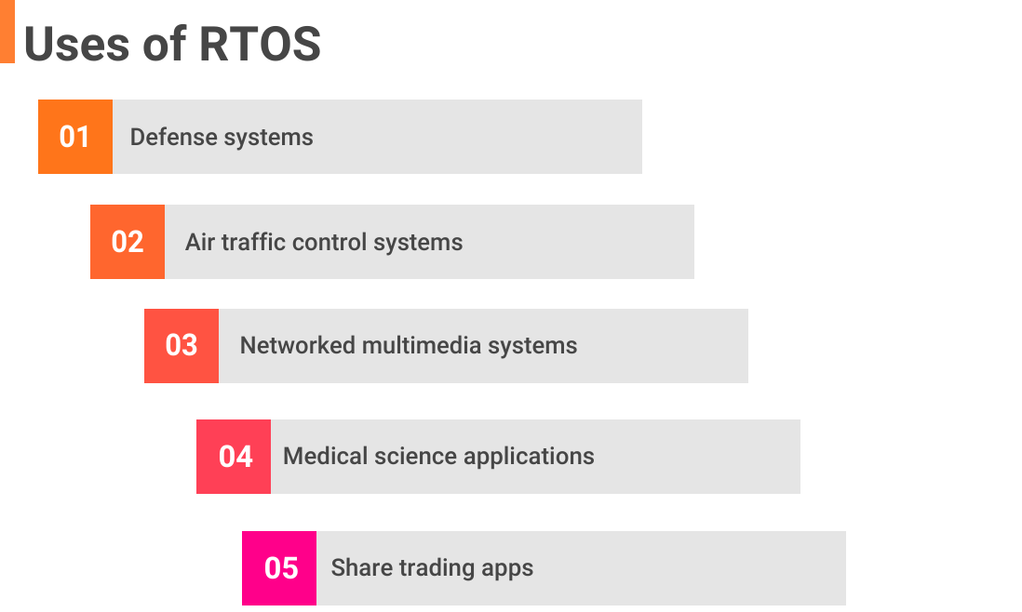

Slide 7
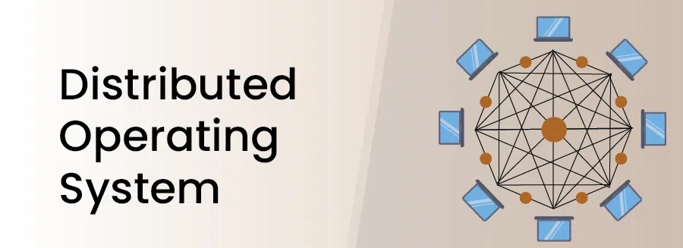
Distributed OS

Slide 8
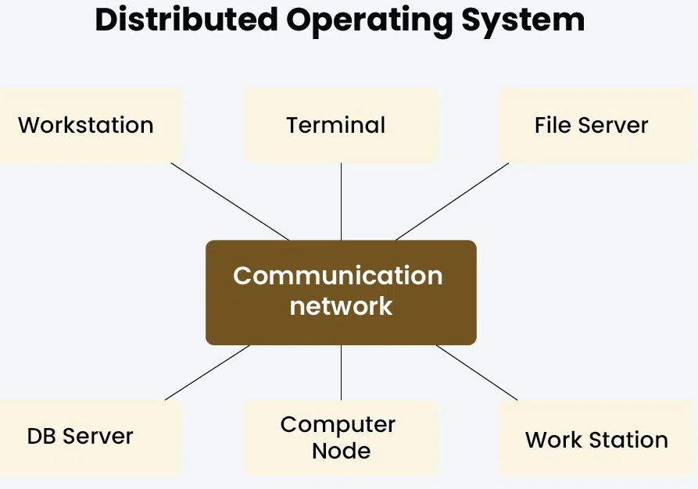
Distributed OS

Slide 9
Characteristics of Distributed Operating System
1. Resource Sharing
2. Concurrency
3. Openness
4. Scalability
5. Fault Tolerance
6. Transparency

Slide 10
Types of Distributed Operating Systems
1. Client Server System
2. Peer-to-peer System
Advantages of Distributed Operating System
1. Data Sharing
2. Ability of extension
3. Error management
4. Reliability
5. Effective
6. Less delay
Disadvantages of Distributed Operating System
1. Security issues
2. High setup cost
3. Lost data
4. Difficult to manage
5. Overload problem

Slide 11
Real-life Example of Distributed Operating System
1. Web search
2. Banking system
3. Massively multiplayer online games

Slide 12
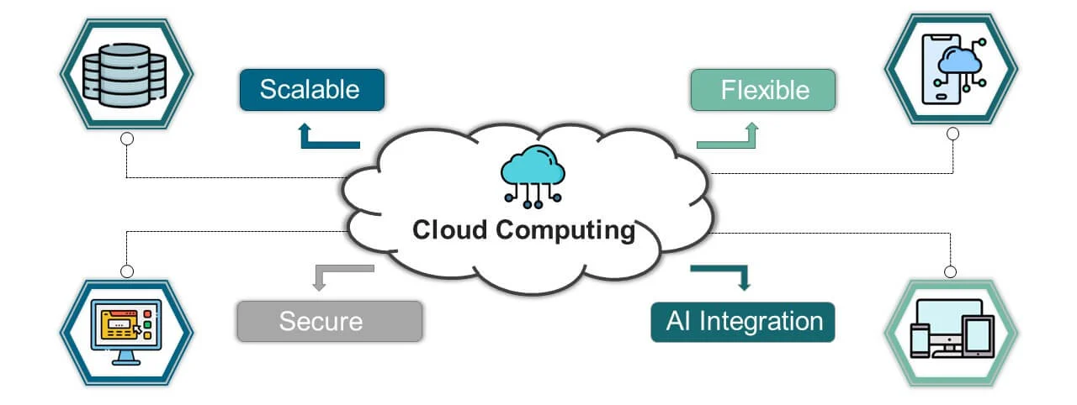
Cloud OS

Slide 13
Features of Cloud OS
Virtualization:
Scalability:
Elasticity:
Resource Pooling:
On-Demand Self-Service:
Broad Network Access:
Multi-Tenancy:
Measured Service:

Slide 14
Advantages and Disadvantages of Cloud OS
Advantages of Cloud Operating System
Accessibility:
Scalability:
Cost-Efficiency:
Automatic Updates and Maintenance:
Disaster Recovery and Backup:
Cross-Platform Compatibility:
Centralized Management:
Disadvantages of Cloud Operating System
Dependence on Internet Connectivity:
Security and Privacy Concerns:
Vendor Lock-In:
Data Ownership Concerns:
Subscription Costs:
Downtime and Reliability:
Performance Limitations:

Slide 15
Applications of Cloud OS
1. Remote Work and Collaboration
2. Data Storage and Backup
3. Social Media and Networking
4. E-Commerce and Online Marketplaces
5. Education and E-Learning
6. Healthcare and Telemedicine
7. Gaming and Entertainment
8. Internet of Things (IoT)
9. Government and Public Services

Slide 16
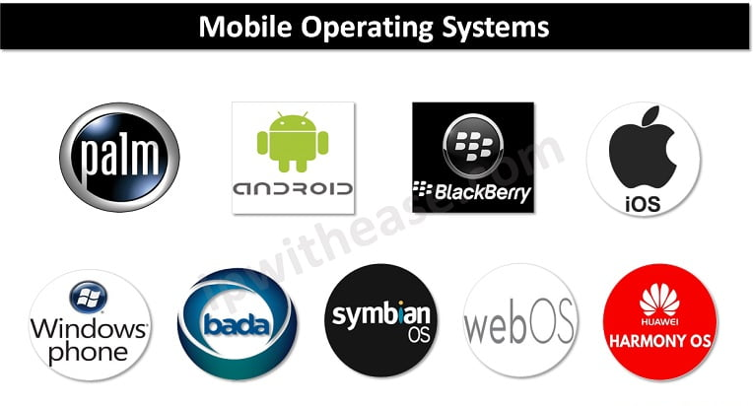
Mobile OS

Slide 17
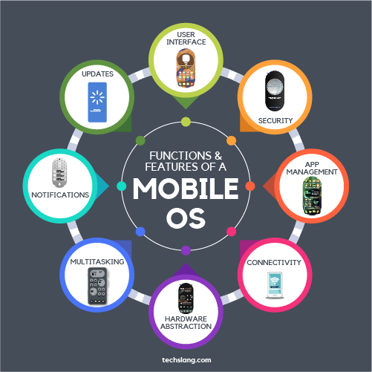
Features of Mobile OS

Slide 18
Function of Mobile OS
1. Hardware Management
2. App Management
3. Security and Privacy
4. Multitasking
5. File Management
6. Accessibility Features
7. IoT and Wearable Integration
8. Developer Support

Slide 19
Advantages and Disadvantages of Mobile OS
Advantages of Mobile Operating Systems
Portability and Convenience:
User-Friendly Interface:
App Ecosystem:
Connectivity:
Multitasking:
Regular Updates:
Customization:
Multimedia Support:
Disadvantages of Mobile Operating Systems
Battery Life:
Security Risks:
Hardware Limitations:
Privacy Concerns:
Dependence on Internet:
Cost:

Slide 20
Security Issues and Method of Deployment of RTOS
Security Issues in RTOS
Limited Resources:
Lack of Built-in Security Features:
Vulnerability to Malware:
Insecure Communication:
Physical Attacks:
Lack of Regular Updates:
Methods to Enhance RTOS Security
Secure Boot:
Encryption:
Authentication and Authorization:
Regular Updates and Patching:
Network Security:
Physical Security:

Slide 21
Method of Deployment of RTOS
1. Bare-Metal Deployment
The RTOS runs directly on the hardware without an underlying general-purpose OS.
Use Cases: Embedded systems, IoT devices, and microcontrollers.
2. Hypervisor-Based Deployment
The RTOS runs alongside other operating systems on a hypervisor, which manages hardware resources.
Use Cases: Systems requiring both real-time and general-purpose computing (e.g., automotive systems, industrial automation).
3. Dual-OS Deployment
The RTOS runs alongside a general-purpose OS (e.g., Linux) on the same hardware.
Use Cases: Devices requiring both real-time and non-real-time functionality (e.g., robotics, medical devices).
4. Cloud-Based Deployment
The RTOS runs on cloud infrastructure, with real-time tasks offloaded to edge devices.
Use Cases: Industrial IoT, smart cities, and large-scale automation systems.

Slide 22
Security Issues of DOS
A. Data Security Issues
B. Network Security Threats
C. System Security Issues
D. Authentication and Access Control Issues

Slide 23
Security Measures in DOS
Strong Encryption
Multi-Factor Authentication (MFA)
Intrusion Detection Systems (IDS)
Regular Patching and Updates
Firewall and Access Control
Backup and Disaster Recovery

Slide 24
Method of Deployment of DOS
A. Centralized Deployment
B. Decentralized Deployment
C. Peer-to-Peer (P2P) Deployment
D. Cloud-Based Deployment
E. Virtualization-Based Deployment

Slide 25
Security Measures and Best Practices in Cloud OS
Key Security Measures in Cloud OS
A. Data Security Measures
B. Network Security Measures
C. Identity & Access Management (IAM)
D. Threat Detection & Incident Response
Security for Cloud OS
A. Secure Cloud Deployment Practices
B. Cloud Security Compliance & Governance.
C. Cloud Backup & Disaster Recovery

Slide 26
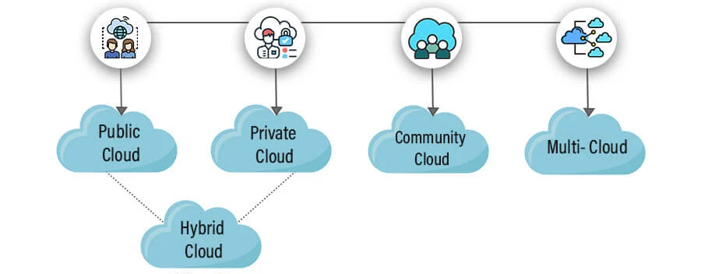
Methods of Deployment in Cloud OS

Slide 27
Memory wall in Operating System
The Memory Wall refers to the growing performance gap between CPU processing speed and memory access speed.
This leads to higher latency in data retrieval, causing a performance bottleneck.
Causes of the Memory Wall
CPU vs. Memory Speed Mismatch
Latency in Memory Hierarchy
Power Consumption & Heat
Von Neumann Bottleneck

Slide 28
Bottleneck for Operating System
An OS bottleneck occurs when system performance is restricted due to resource limitations.
Types of OS Bottlenecks
CPU Bottleneck
  High CPU utilization (90-100%) causes slow system response.
  Solution: Load balancing, CPU scheduling (Round Robin, Multi-Level Queue).
Memory Bottleneck
  Low available RAM leads to paging/swapping.
  Solution: Use virtual memory, memory compression, better cache management.
I/O Bottleneck
  Slow disk read/write speeds limit performance.
  Solution: Use SSD/NVMe storage, optimize disk I/O scheduling.
Network Bottleneck
  Limited bandwidth or high latency slows communication.
  Solution: Use load balancing, QoS (Quality of Service), and better routing algorithms.

Slide 29
Overcoming Memory Wall & Bottlenecks
A. Architectural Solutions
✔ Memory Hierarchy Optimization
✔ Non-Volatile Memory (NVM)
✔ Processing-in-Memory
✔ Parallelism & Multi-Threading:
B. OS-Level Solutions
✔ Efficient Memory Management
✔ Smart Scheduling
✔ Compression & Data Deduplication

Slide 30
End of Unit

Slide 31
THANK YOU

